Slide 1


Drapo App V2: E-Bhutan Digital Identity & Citizenship Platform
Welcome to the future of digital identity and citizenship! Drapo App V2 is a comprehensive, decentralised platform designed to empower Bhutanese citizens with secure digital identities, efficient government services, and innovative financial tools.
by Kiran S

Slide 2





Decentralised Digital Identity (DID) & Digital Passport
Self-Sovereign Identity (SSI)
Users create their own identity stored on a decentralised ledger.
Bhutanese Digital Passport
Secure digital passport for seamless international travel.
Verifiable Credentials
Issue and manage education, business, and tax compliance credentials.
Biometric Authentication
Enhanced security with face and fingerprint recognition.

Slide 3

Proof-of-Personhood (PoP) & Reputation System
Drapo App V2 establishes robust identity verification through AI-powered facial recognition and government-issued documents, complemented by Web3-based proof via Soulbound Tokens and Zero-Knowledge Proofs. Citizens earn reputation points for verified contributions like community work, education, and business activities.
This reputation score unlocks premium services, scholarships, and business opportunities within Bhutan. A smart contract-based trust system with verifiable attestations ensures a transparent and secure credibility framework.

Slide 4
Bitcoin-Backed Digital Currency & Wallet
100%
Secure
Transparent
Bitcoin-Backed
Digital Wallet
Reserve Management
Stablecoin pegged to the Bhutanese Ngultrum.
For sending, receiving, and exchanging currencies securely.
Transparent Bitcoin backing ensures trust and stability.

Slide 5

eResidency & Business Services
Digital Business Registration: Streamlined online incorporation process.
Tax Management: Simplified tax compliance and filing services.
Document Verification: Secure storage and verification of important documents.
NFT-based Certificates: Issuance of digital credentials and certificates as NFTs.

Slide 6

Sovereign AI Assistant
Legal & Regulatory Guidance
Government Services
Access quick and accurate legal and compliance advice.
AI-powered assistance for all government interactions.
Bhutanese Law FAQ
Dzongkha Language Support
Instant answers to common questions on Bhutanese law.
Ensuring accessibility for all local users.

Slide 7

Secure Identity Verification & Document Storage
Drapo App V2 prioritises security and privacy with advanced features for identity verification and document storage.
AI-powered OCR Scanning
For precise and efficient document verification.
IPFS/Filecoin Storage
Decentralised and secure storage of all credentials.
Zero-Knowledge Proofs (zkProofs)
Protecting identity while enabling verification.
Selective Disclosure
You control what personal information you share.

Slide 8

Key Differentiators & Benefits
Drapo App V2 is a game-changer for Bhutan, providing a holistic and secure digital infrastructure.
Secure Digital Identity: For all Bhutanese citizens.
Bitcoin-Backed Digital Currency: Ensures transparency and stability.
Trust & Reputation: Built through blockchain attestations.
Comprehensive Government Services: Enhanced by AI assistance.
Decentralised Storage & AI: For unparalleled security and privacy.
Citizen Empowerment: Self-sovereign identity and control.

Slide 9
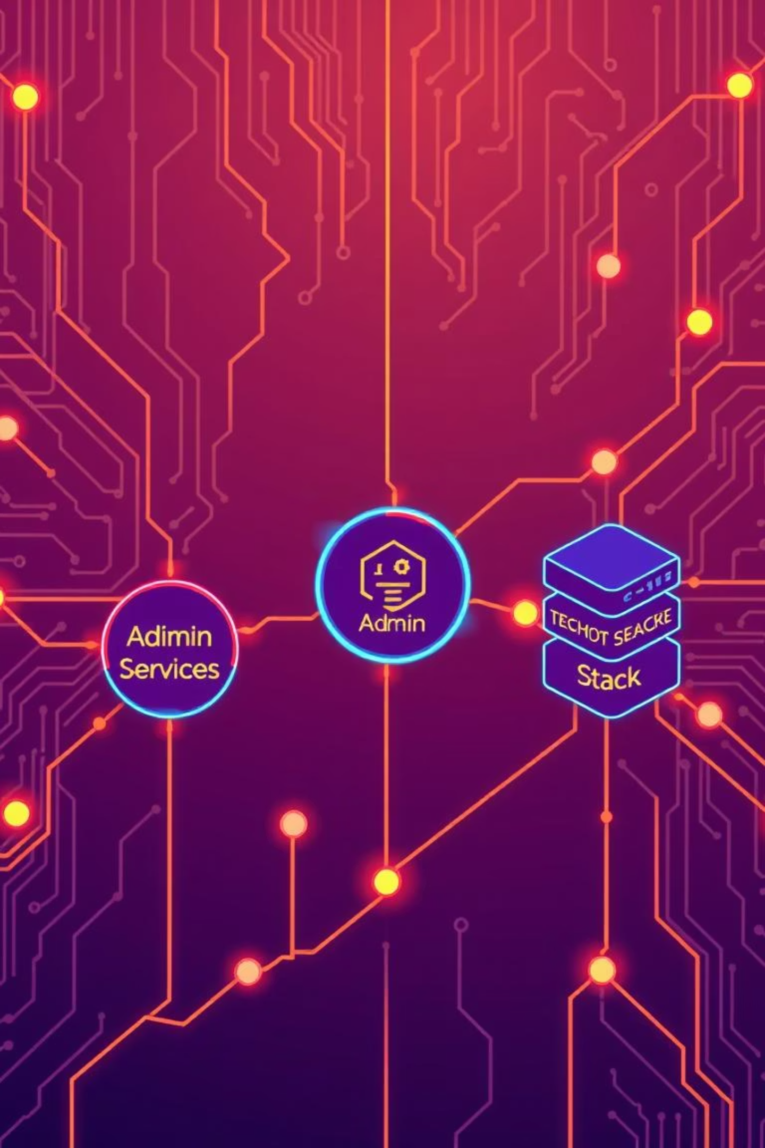



Future Vision: Architecture & Ecosystem
Citizen Services
Identity, Reputation, Wallet, Business, AI Assistant
Admin Panel
System Overview, User, Reputation, Smart Contract, Currency, AI
Tech Stack Core
Frontend, Backend, Blockchain, AI/ML, Smart Contracts
Drapo App V2 envisions a robust ecosystem with interconnected citizen services and an efficient admin panel, underpinned by a cutting-edge tech stack to ensure a seamless and secure digital experience for all.

